Slide 1
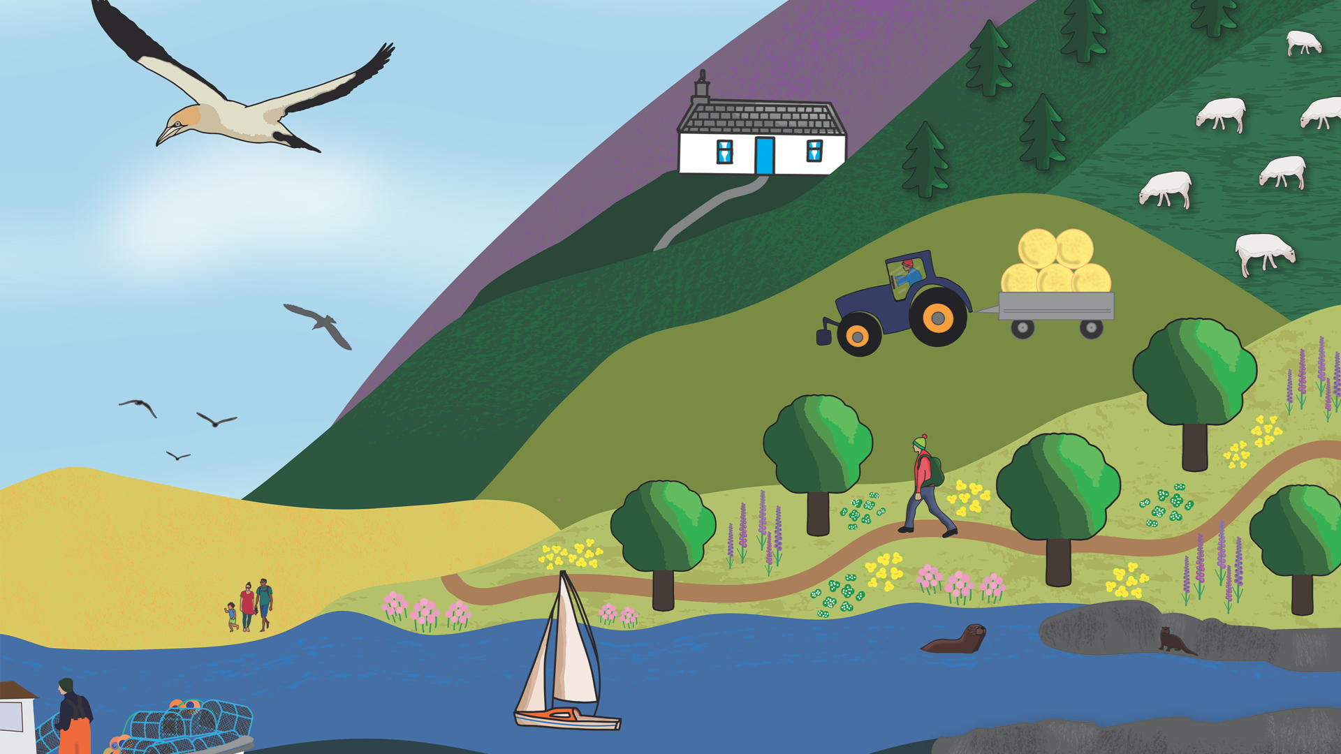


Slide 2



Saltmarshes
ACTIVITY 1: Saltmarsh Scramble!
PS: 2/3

Slide 3
Saltmarsh Scramble!
ACTIVITY 1
FOLLOWING THIS ACTIVITY, YOU SHOULD UNDERSTAND:
Why saltmarshes are protected and the importance of Special Areas of Conservation (SACs)
What animals need to survive
What makes a good habitat
How the environment affects wildlife populations
SKILLS YOU WILL DEVELOP:
Talking and listening
Thinking carefully and making decisions
Working as a team
Using numbers and handling information

Slide 4

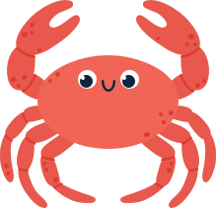
What is a Special Area of Conservation (SAC)?
ACTIVITY 1: Saltmarsh Scramble!
SACs are protected areas designated under the Conservation of Habitats and Species Regulations in Wales.
Saltmarshes
These areas are chosen because they contain rare, threatened or important habitats and species.
PS: 2/3

Slide 5
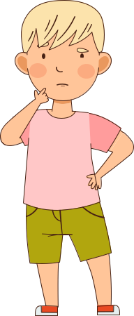
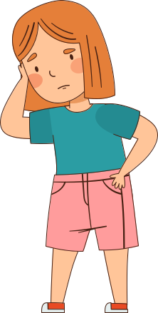
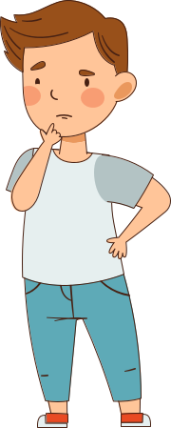
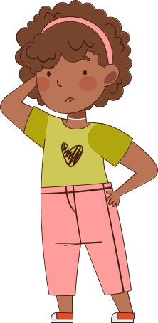

Why are SACs important in Wales?
I think SACs are all about helping animals like otters and seals survive.
I think SACs are conservation sites, which safeguard species such as harbour porpoises.
I think Marine SACs protect habitats such as saltmarshes and reefs.
I believe SACs are chosen to protect places where animals breed or stop to feed when they’re migrating.
ACTIVITY 1: Saltmarsh Scramble!
Saltmarshes
PS: 2/3
DYLAN
CARYS
EFAN
MAYA

Slide 6
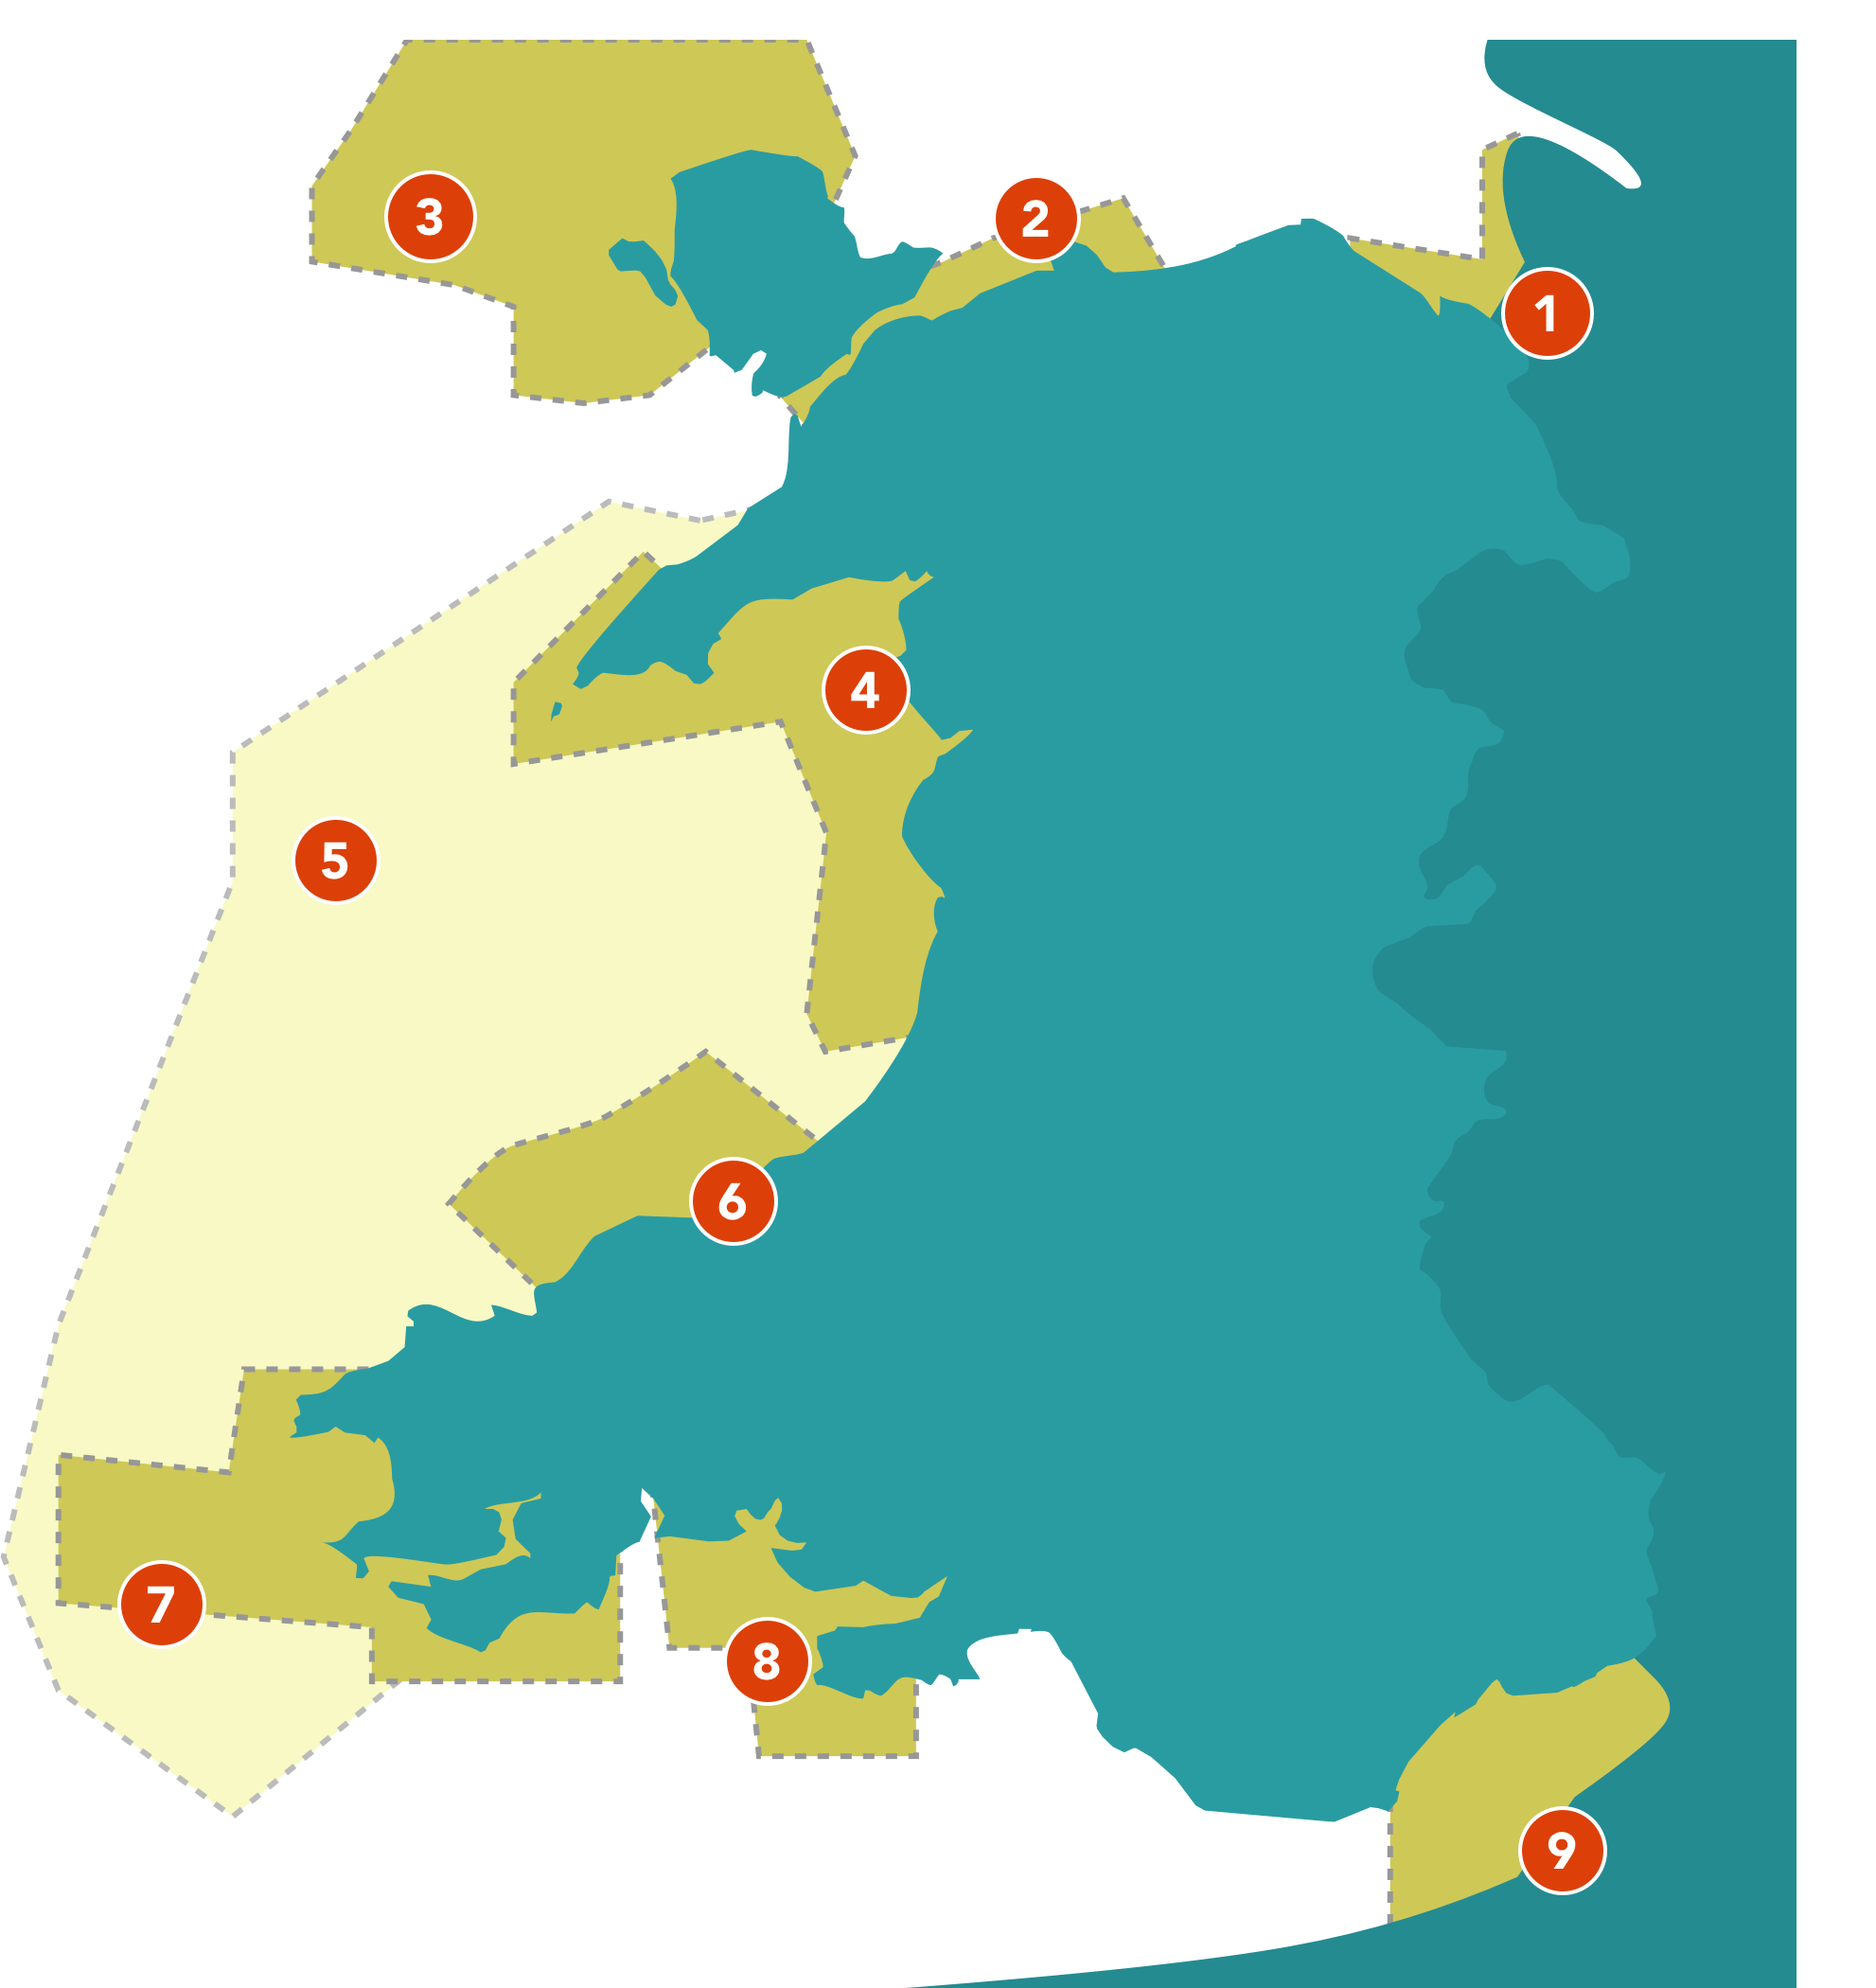
SACs in Wales
Where is the closest Marine SAC to you? What features could it protect?
ACTIVITY 1: Saltmarsh Scramble!
Saltmarshes
1. Dee Estuary SAC
2. Menai Strait and Conwy Bay SAC
3. North Anglesey Marine SAC
4. Pen Llŷn a’r Sarnau SAC
5. West Wales Marine SAC
6. Cardigan Bay SAC
7. Pembrokeshire Marine SAC
8. Carmarthen Bay and Estuaries SAC
9. Severn Estuary SAC
PS: 2/3

Slide 7
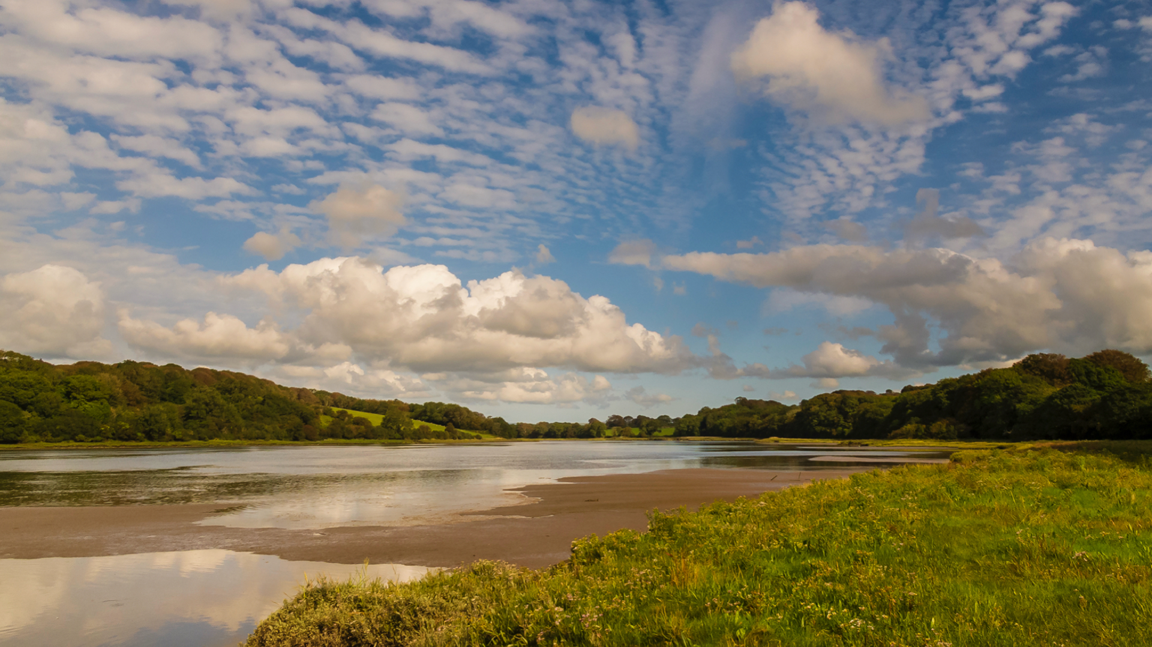
What can you see?
What kind of habitat can you see?
Why do you think the habitat may be protected as a Special Area of Conservation?
ACTIVITY 1: Saltmarsh Scramble!
Saltmarshes
PS: 2/3
PHOTO: John Archer-Thompson

Slide 8
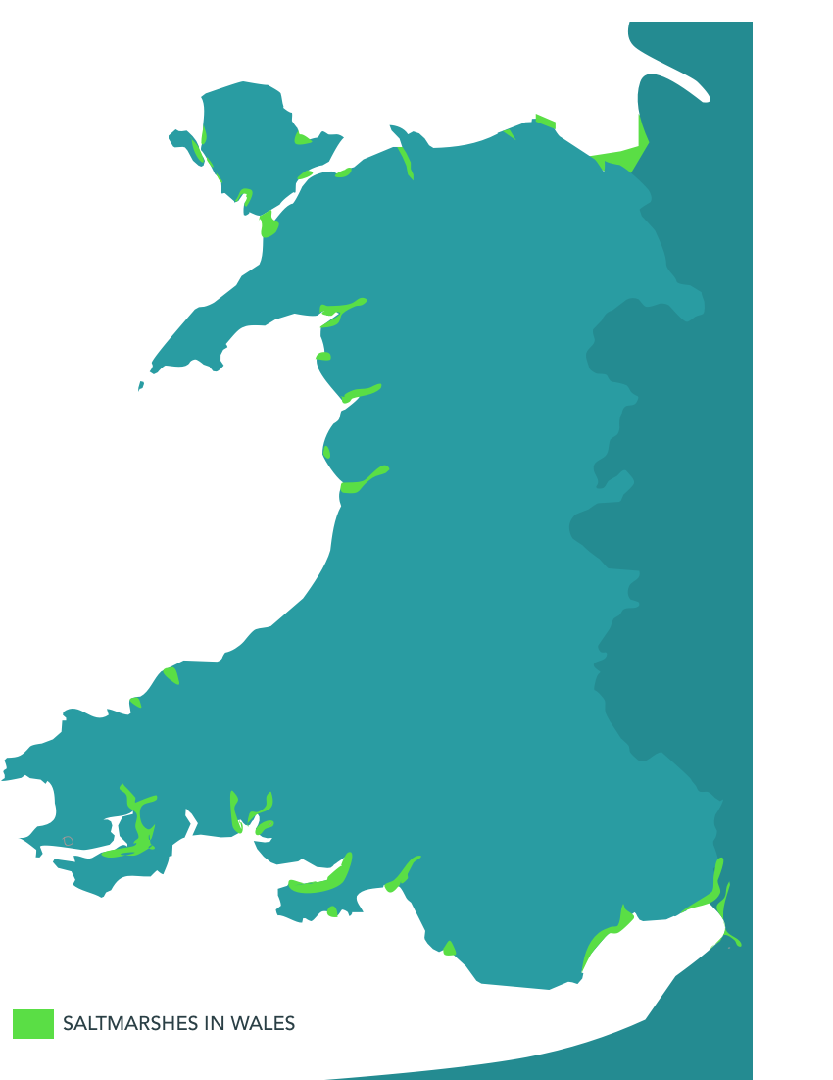
Saltmarshes in Wales
Can you find the closest Saltmarsh to you?
How could you get there and what might you see when you arrive?
ACTIVITY 1: Saltmarsh Scramble!
Saltmarshes
PS: 2/3

Slide 9

Habitat Elements
What are the main elements of a habitat?
ACTIVITY 1: Saltmarsh Scramble!
FOOD
WATER
Saltmarshes
SHELTER
SPACE
Can you think of an action that represents these elements?
DYLAN IS HOLDING HIS HAND TO HIS MOUTH. THIS ACTION REPRESENTS FOOD
PS: 2/3

Slide 10
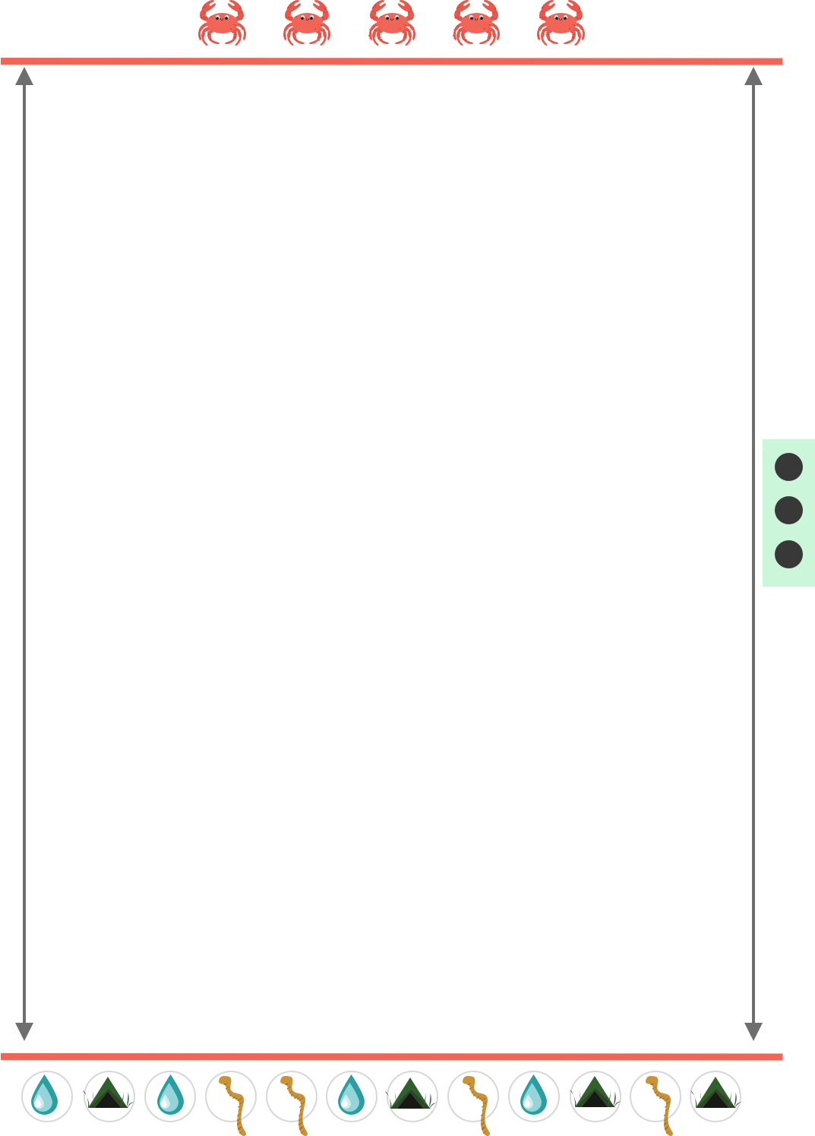
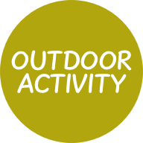
Saltmarsh
Scramble
CRAB LINE
ACTIVITY 1: Saltmarsh Scramble!
It’s time to play outside!
PREDATOR DEN
APPROX 10m
Saltmarshes
PS: 2/3
HABITAT COMPONENT FOOD/WATER/SHELTER

Slide 11

Crab-tastic Challenges
Additional Task
Research Task
ACTIVITY 1: Saltmarsh Scramble!
Use the data gathered during the activity to create a graph to show how the crab population has changed over time.
Then, analyse any trends you observe.
Visit the North Wales Wildlife Trust website www.tiramor.cymru/saltmarshes (Resource 1) to find out what shore crabs look like, where they live, what they eat, and how they survive in their habitat.
Saltmarshes
PS: 2/3

Slide 12





