Slide 1
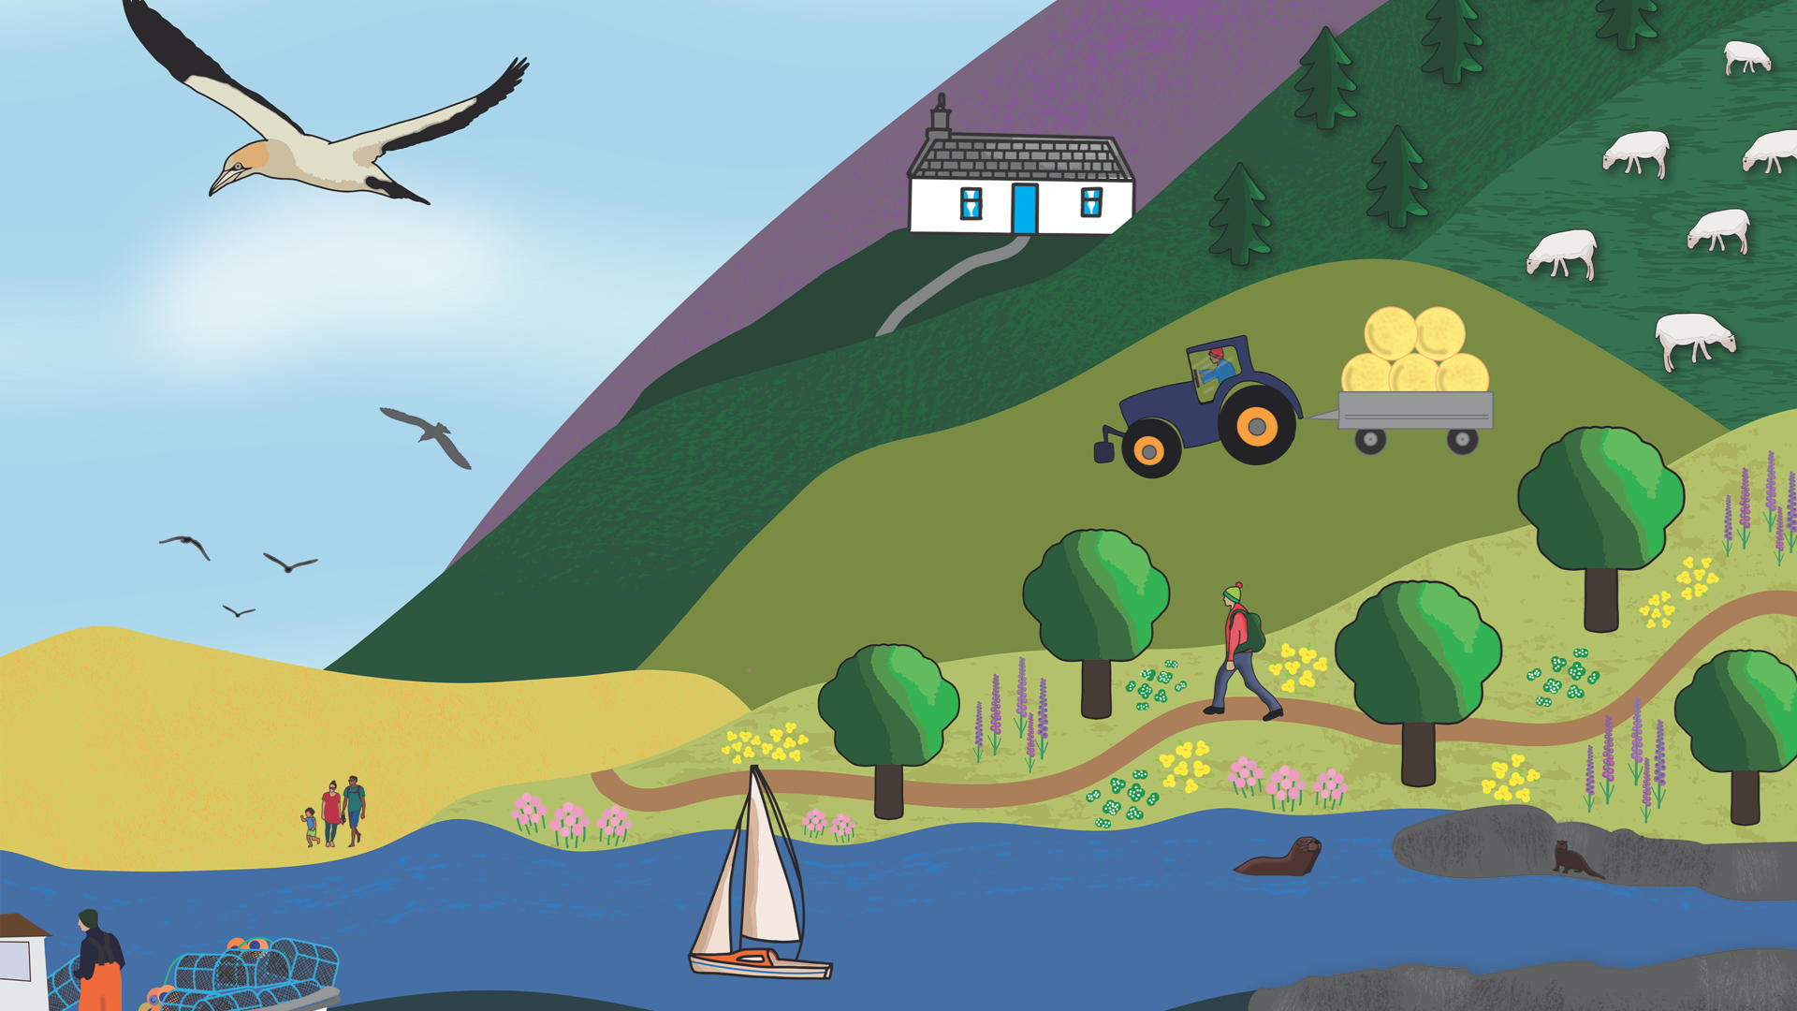


Slide 2



Saltmarshes
ACTIVITY 3: Saltmarsh Nurseries
PS: 2/3

Slide 3
Saltmarsh Nurseries
ACTIVITY 3
FOLLOWING THIS ACTIVITY, YOU SHOULD UNDERSTAND:
Why saltmarshes are great nursery habitats for young fish
How fish grow and change through different stages of their life cycle
SKILLS YOU WILL DEVELOP:
Observing how fish grow and change
Putting things in the right order
Sharing and explaining your ideas

Slide 4
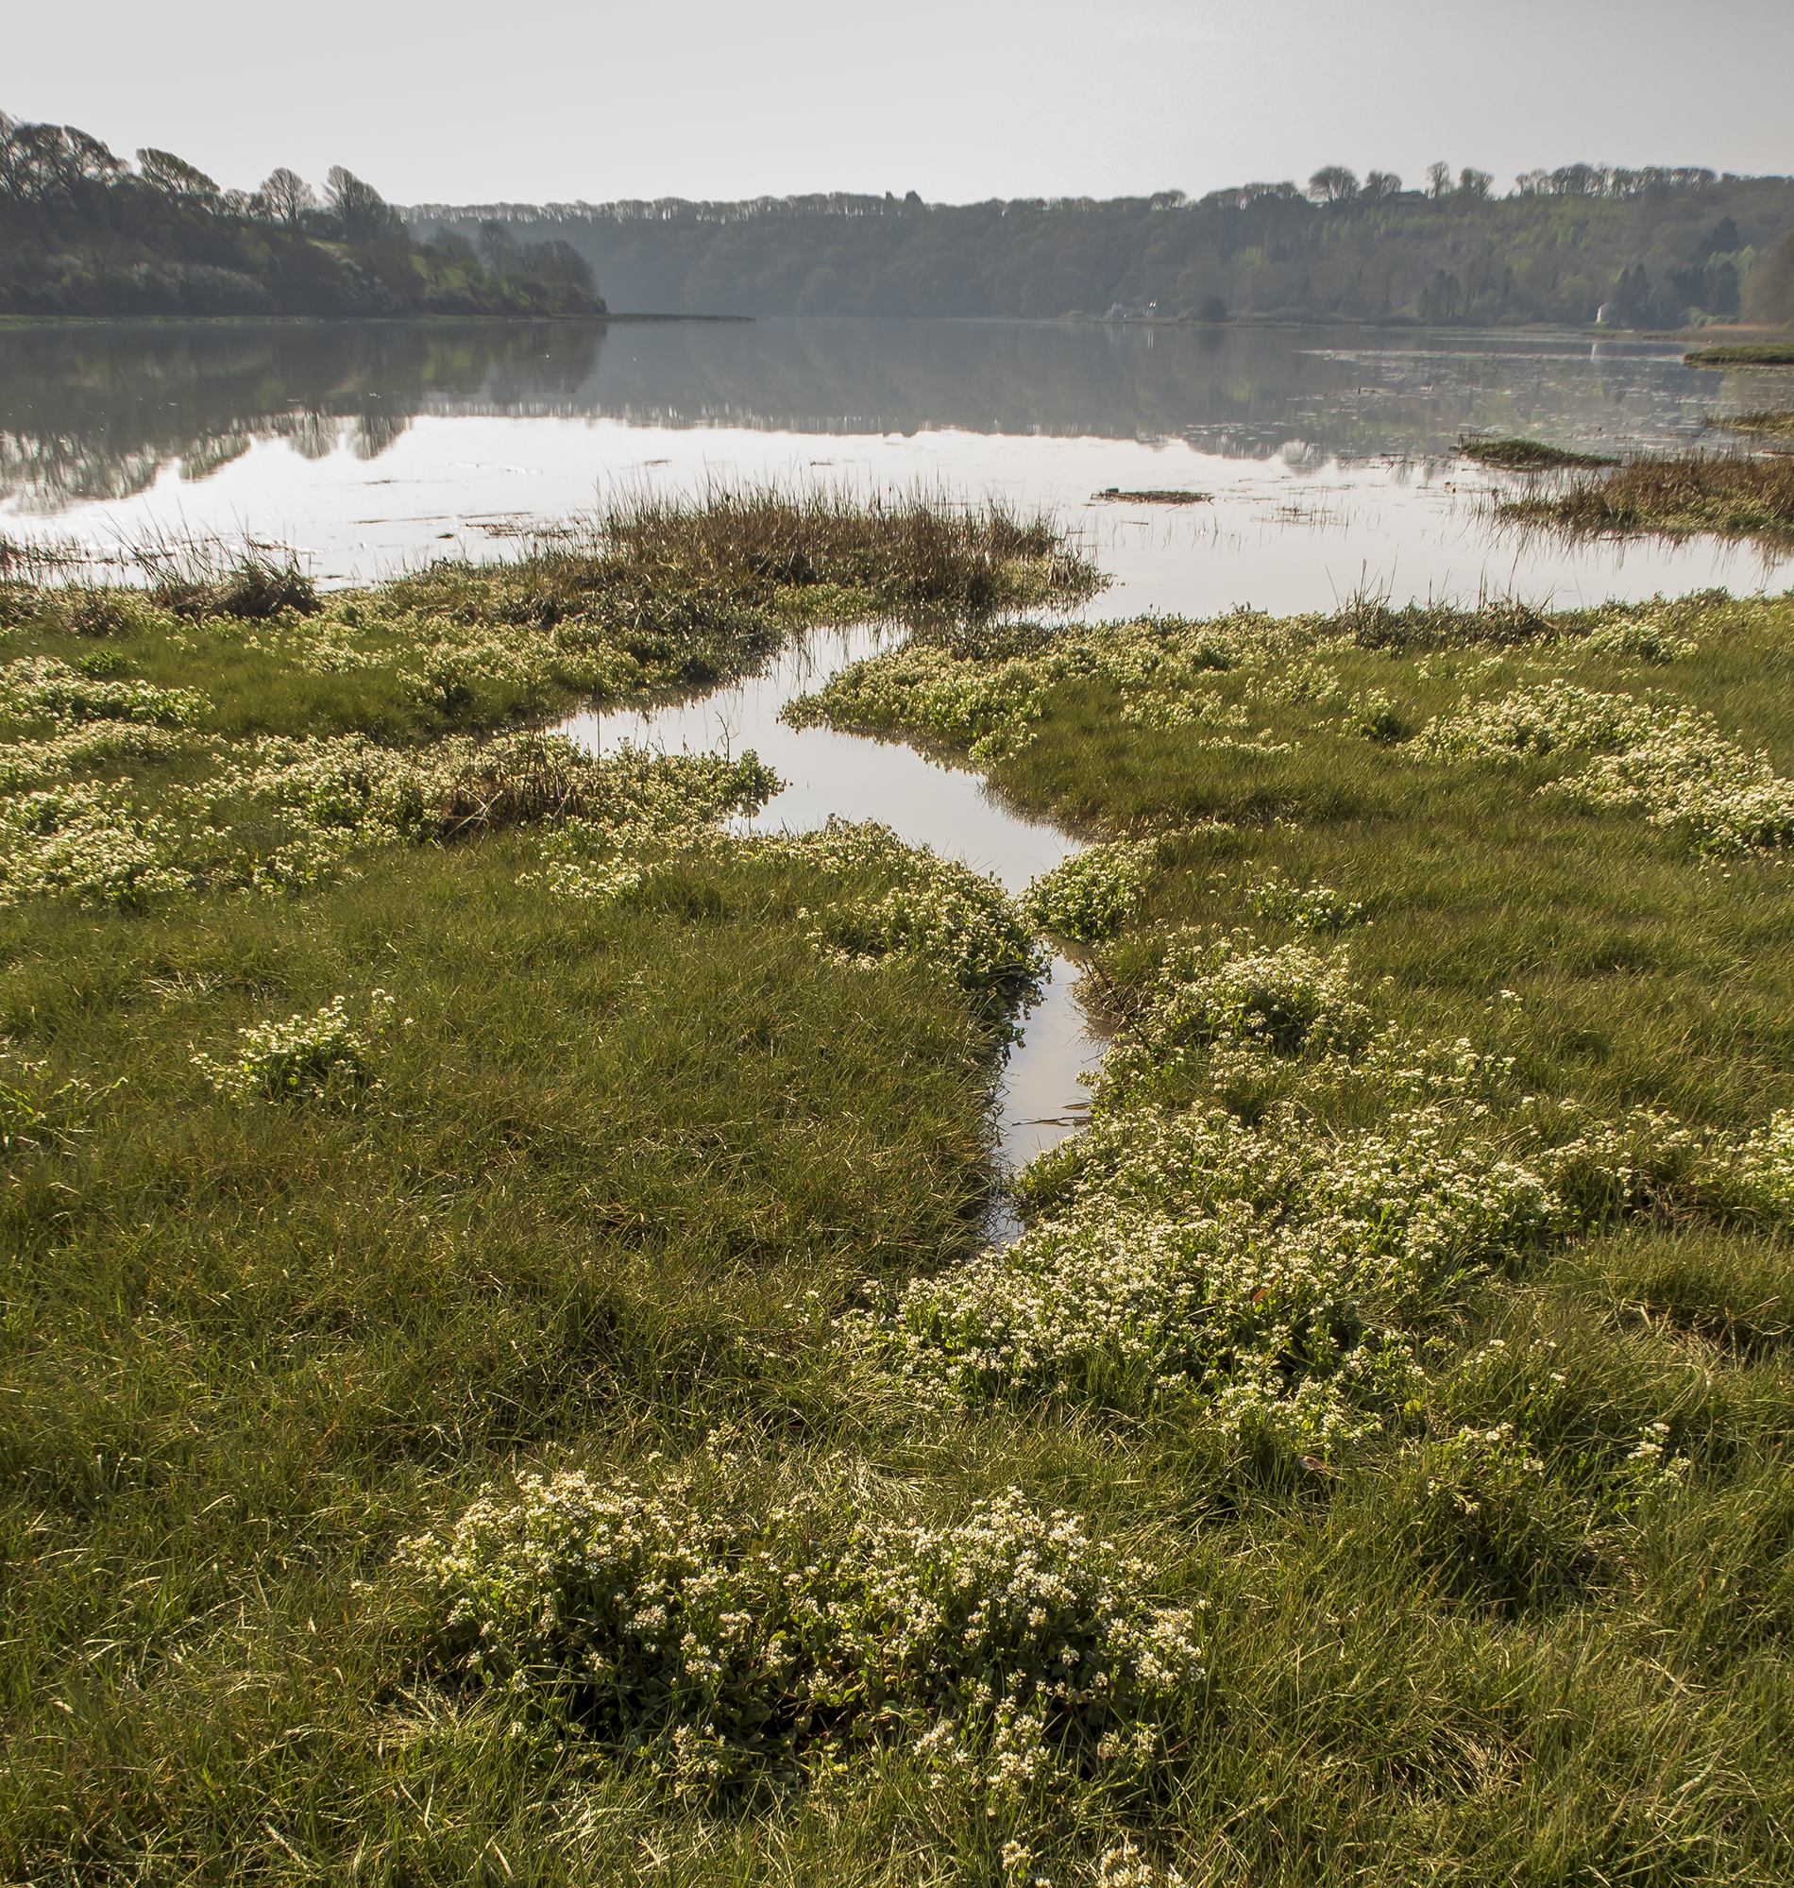
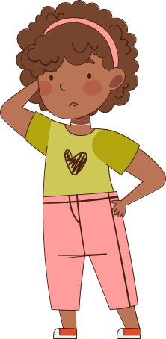
Would a saltmarsh make a good nursery for young fish?
ACTIVITY 3: Saltmarsh Nurseries
Saltmarshes
Why do you think this?
Make a note of key features
PS: 2/3
PHOTO: John Archer-Thompson

Slide 5
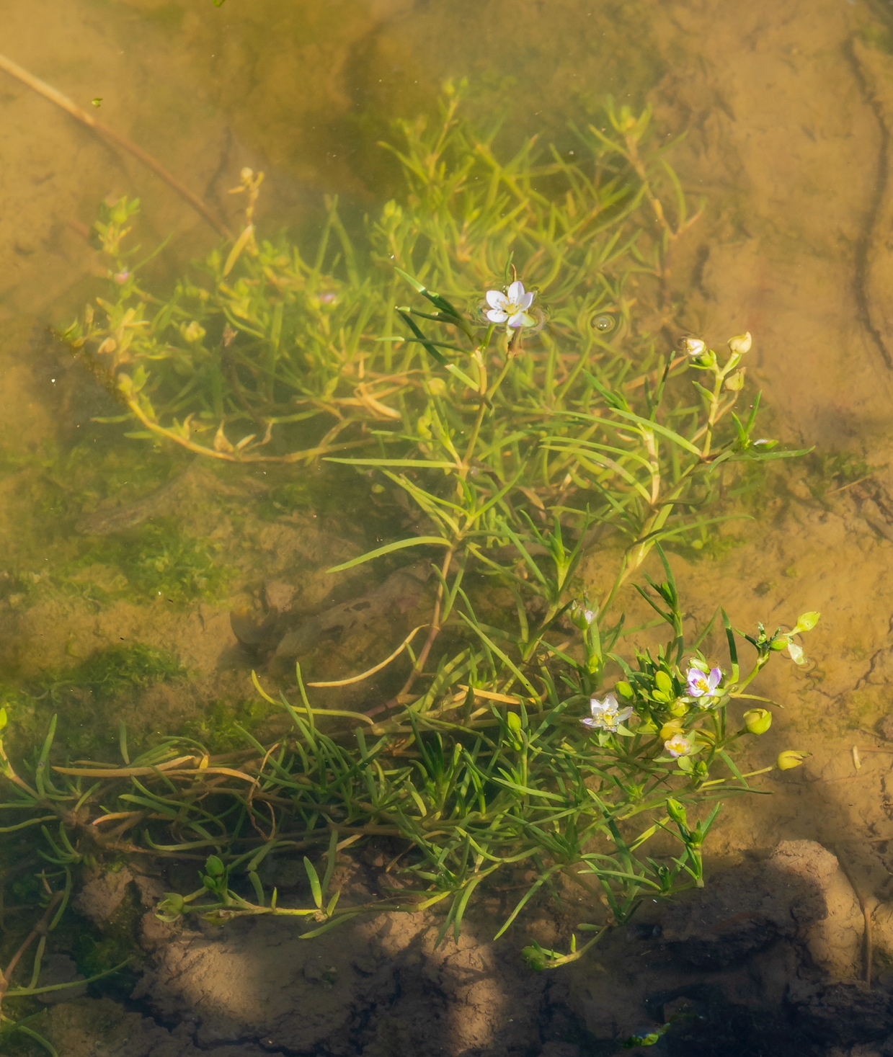


Imagine
Imagine you are a young fish living in a saltmarsh
ACTIVITY 3: Saltmarsh Nurseries
Saltmarshes
What can you see?
What would you eat?
Where would you hide?
Who might be nearby - a friend or a threat?
PS: 2/3
Write down or draw your ideas

Slide 6
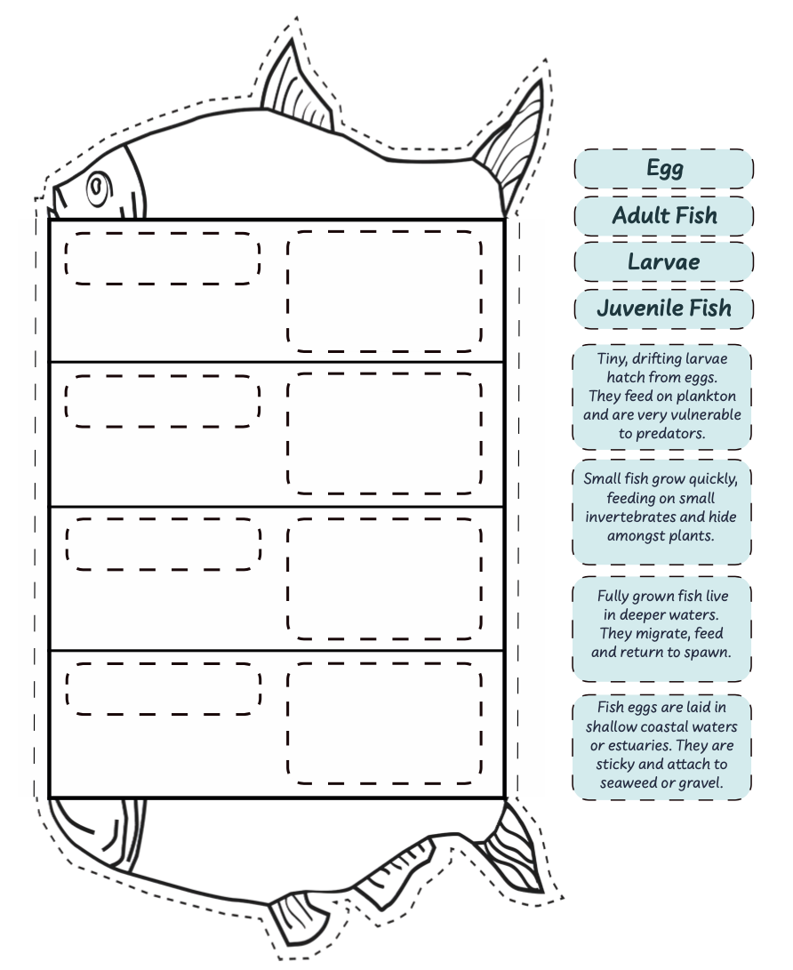
Fish Life Cycle
STEP 1
STEP 2
ACTIVITY 3: Saltmarsh Nurseries
Cut out the fish, life cycle stages and descriptions on the worksheet.
Put the stages in the correct order, discussing changes in size, location, diet, or threats over time.
Saltmarshes
STEP 3
STEP 4
Glue the life cycle descriptions onto the fish template.
Fold along the lines to create your fish life cycle foldout.
PS: 2/3

Slide 7
Design your own
Additional Task
ACTIVITY 3: Saltmarsh Nurseries
Design a perfect saltmarsh nursery for young fish
Saltmarshes
Draw and label your fish’s habitat or make a simple 3D model.
Try to show things like where the fish finds food, places it can hide, shallow water, and how the habitat keeps it safe.
Share your design with the class and explain how each part helps the fish survive.
PS: 2/3

Slide 8





