Slide 1
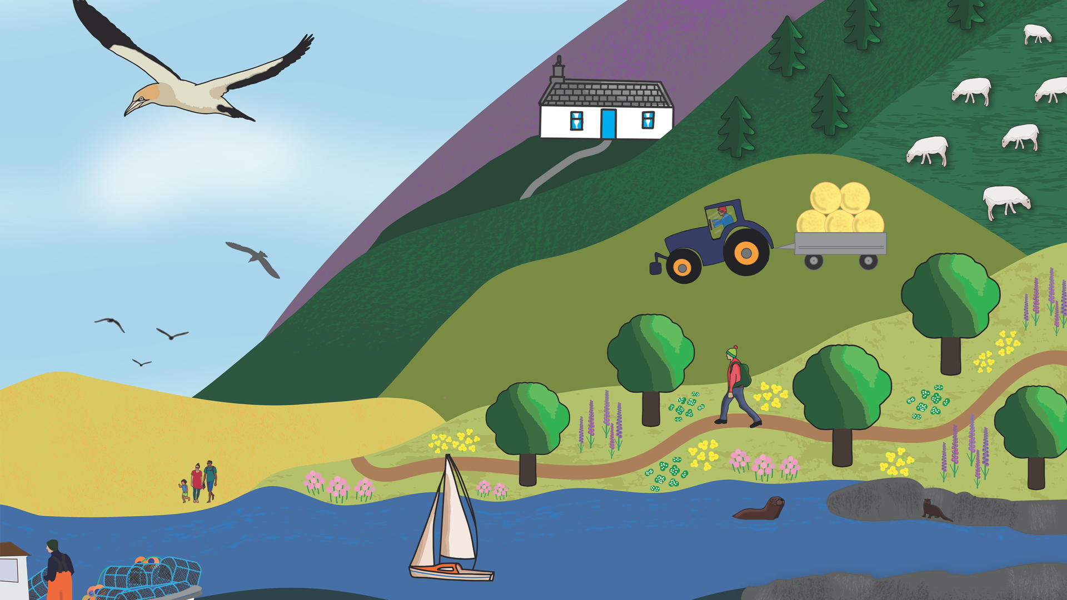


Slide 2



Saltmarshes
ACTIVITY 2: Saltmarsh Connections
PS: 3

Slide 3
Saltmarsh Connections
ACTIVITY 2
FOLLOWING THIS ACTIVITY, YOU SHOULD UNDERSTAND:
How species, habitats and natural processes are interconnected in the saltmarsh ecosystem
How saltmarshes support both wildlife and people
SKILLS YOU WILL DEVELOP:
Critical thinking
Communicating your ideas
Working with others
Discussing opinions
Reasoning

Slide 4

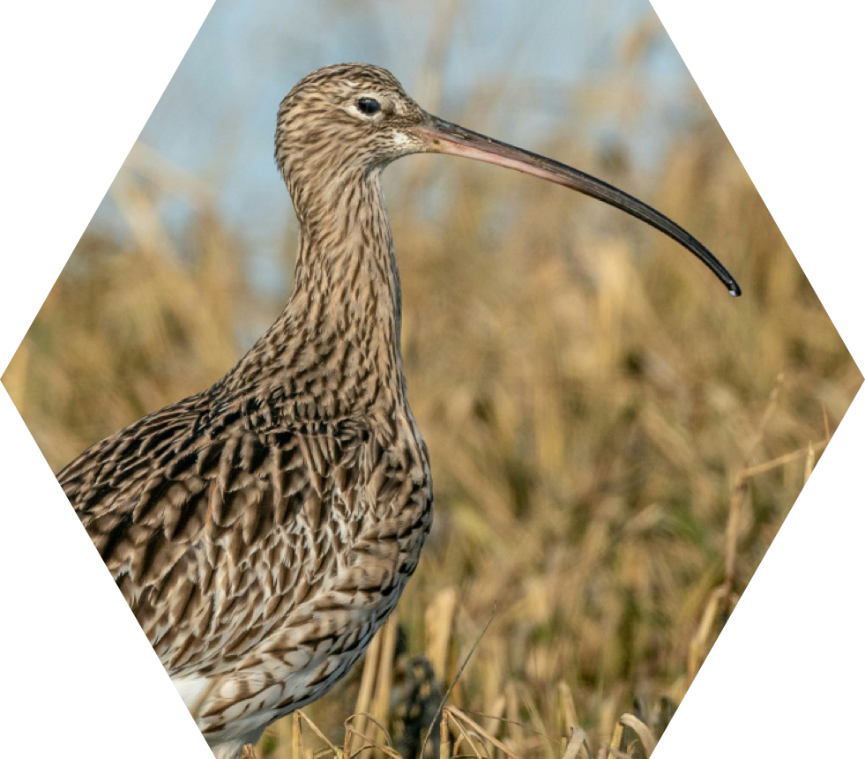
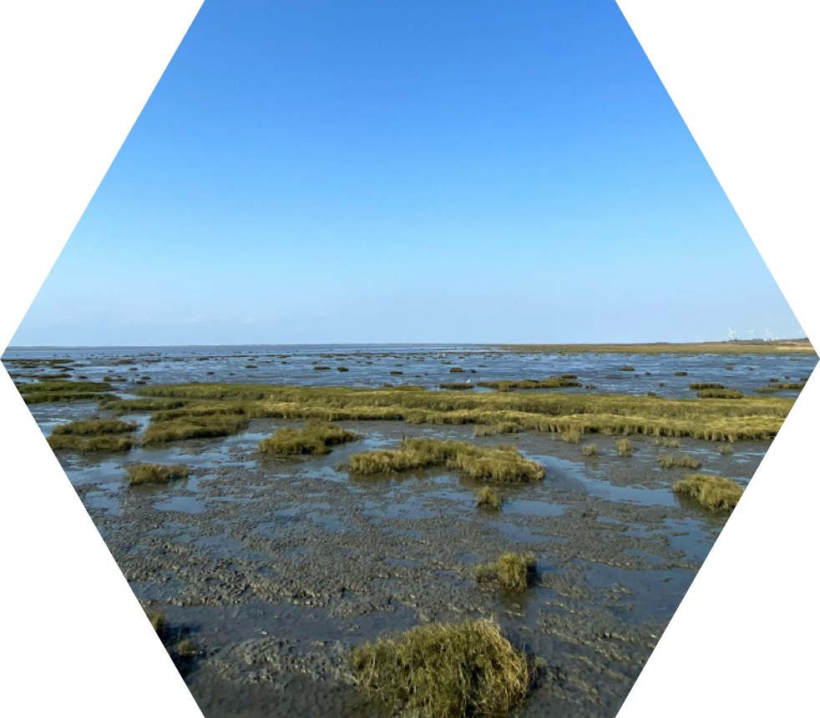
Connections
With a partner, look closely at these photos.
Can you describe how they connect? Be ready to share your connection with the class.
ACTIVITY 2: Saltmarsh Connections
Saltmarshes
PS: 3
Curlew
Saltmarsh

Slide 5
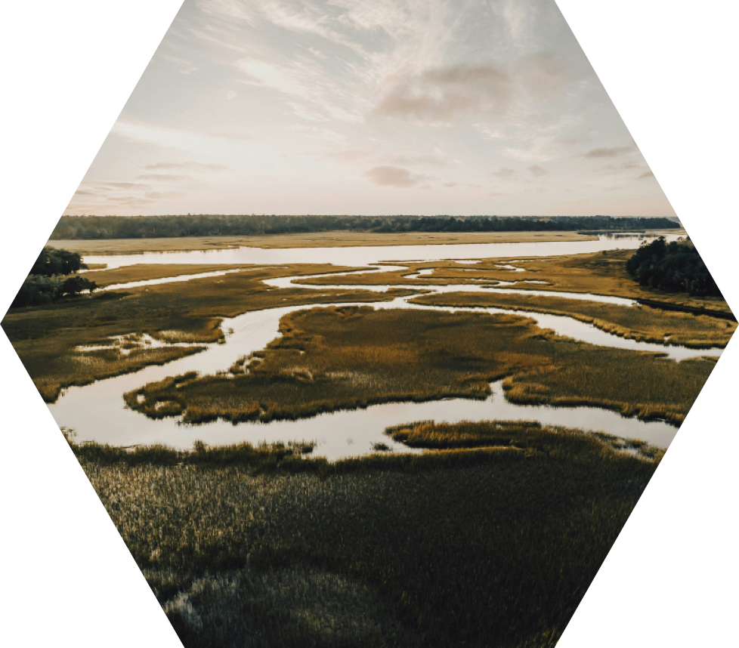
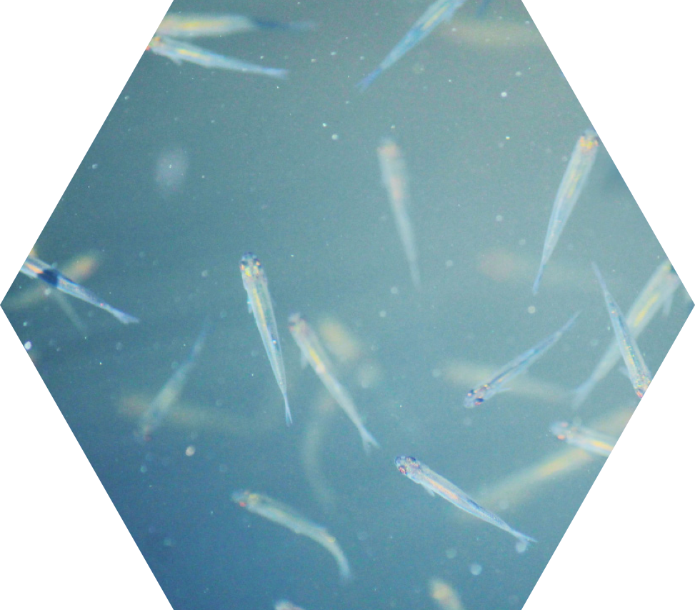
Connections
With a partner, look closely at these photos.
Can you describe how they connect?
ACTIVITY 2: Saltmarsh Connections
Saltmarshes
PS: 3
Saltmarsh
Young Fish

Slide 6

Connections
Work in pairs to discuss how these two concepts connect.
ACTIVITY 2: Saltmarsh Connections
Saltmarshes
Blue Carbon
Climate Change
Saltmarsh
PS: 3
Use the internet or any resources you have if you’re unsure what the terms mean.

Slide 7
Connections
How many links can you make?
Can you link more than two cards?
Young Fish
ACTIVITY 2: Saltmarsh Connections
Saltmarshes
Saltmarsh
Sea Level Rise
Climate Change
Habitat Loss
PS: 3

Slide 8
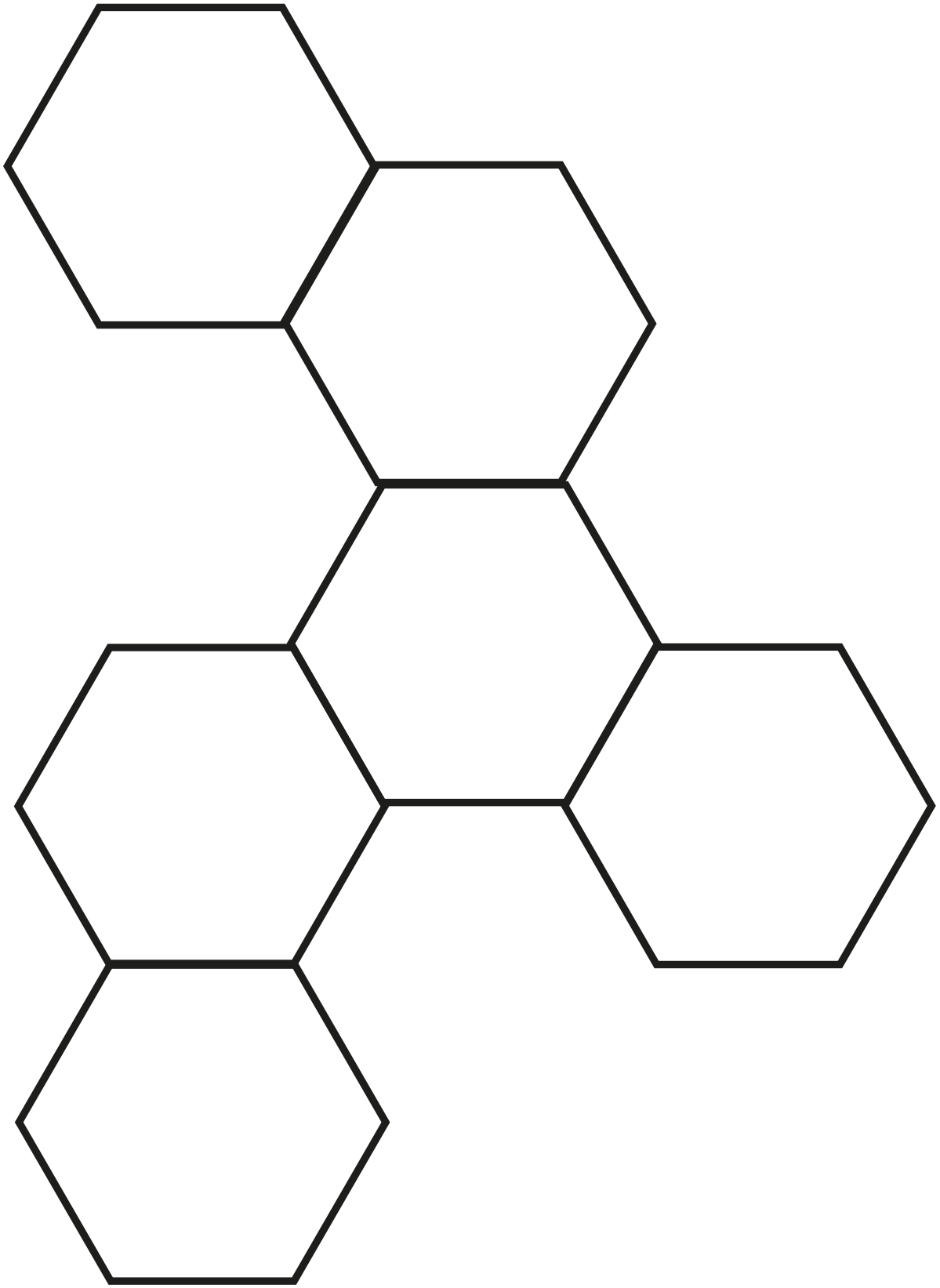
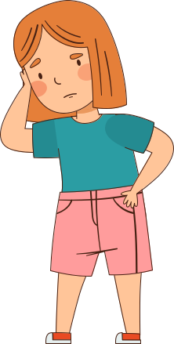
Saltmarsh Connections
YOUR MISSION
WHAT YOU WILL NEED
Copy of S_SM_1 worksheet (Page 1 or Page 1&2)
Scissors
Paper and pencil to keep score
Internet-enabled device (optional, for research)
ACTIVITY 2: Saltmarsh Connections
Work as a team to build a hexagonal grid that shows how different saltmarsh ideas are connected.
The more meaningful connections you can make, the more points you score!
Saltmarshes
PS: 3

Slide 9
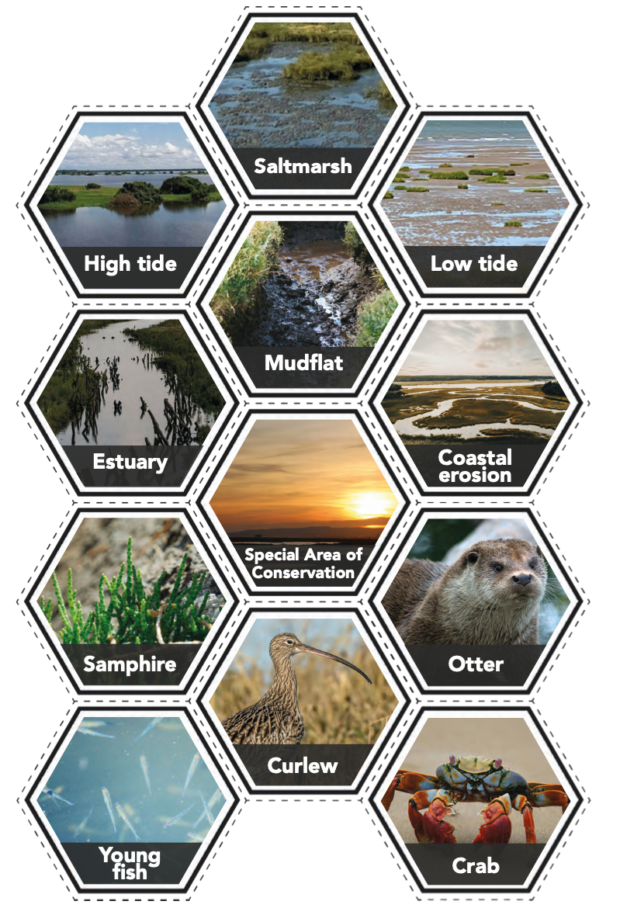
Play!
STEP 1
STEP 2
STEP 3
ACTIVITY 2: Saltmarsh Connections
Cut out the cards and share equally among your group.
Take turns placing your cards in a honeycomb/ hexagon layout, clearly explaining the connection.
Write down your points each time a player places a card down.
Saltmarshes
SCORING 1 CARD = 1 POINT 2 CONNECTED CARDS = 2 POINTS 3 CONNECTED CARDS = 3 POINTS etc...
RULES Each touching edge must show a meaningful link between the cards. You must be able to explain each connection clearly. Take turns placing cards and record your team’s points as you go.
PS: 3
At the end, be ready to share: The most interesting or surprising connection you made. What this task has helped you understand about saltmarshes.

Slide 10
Reflect and Share
What was the most interesting or surprising connections you made?
Did any connections surprise you?
What did this activity help you to understand about saltmarshes?
ACTIVITY 2: Saltmarsh Connections
Saltmarshes
How many cards did you place down?
How many points did your team score?
How would you improve your score next time?
PS: 3

Slide 11





