Slide 1
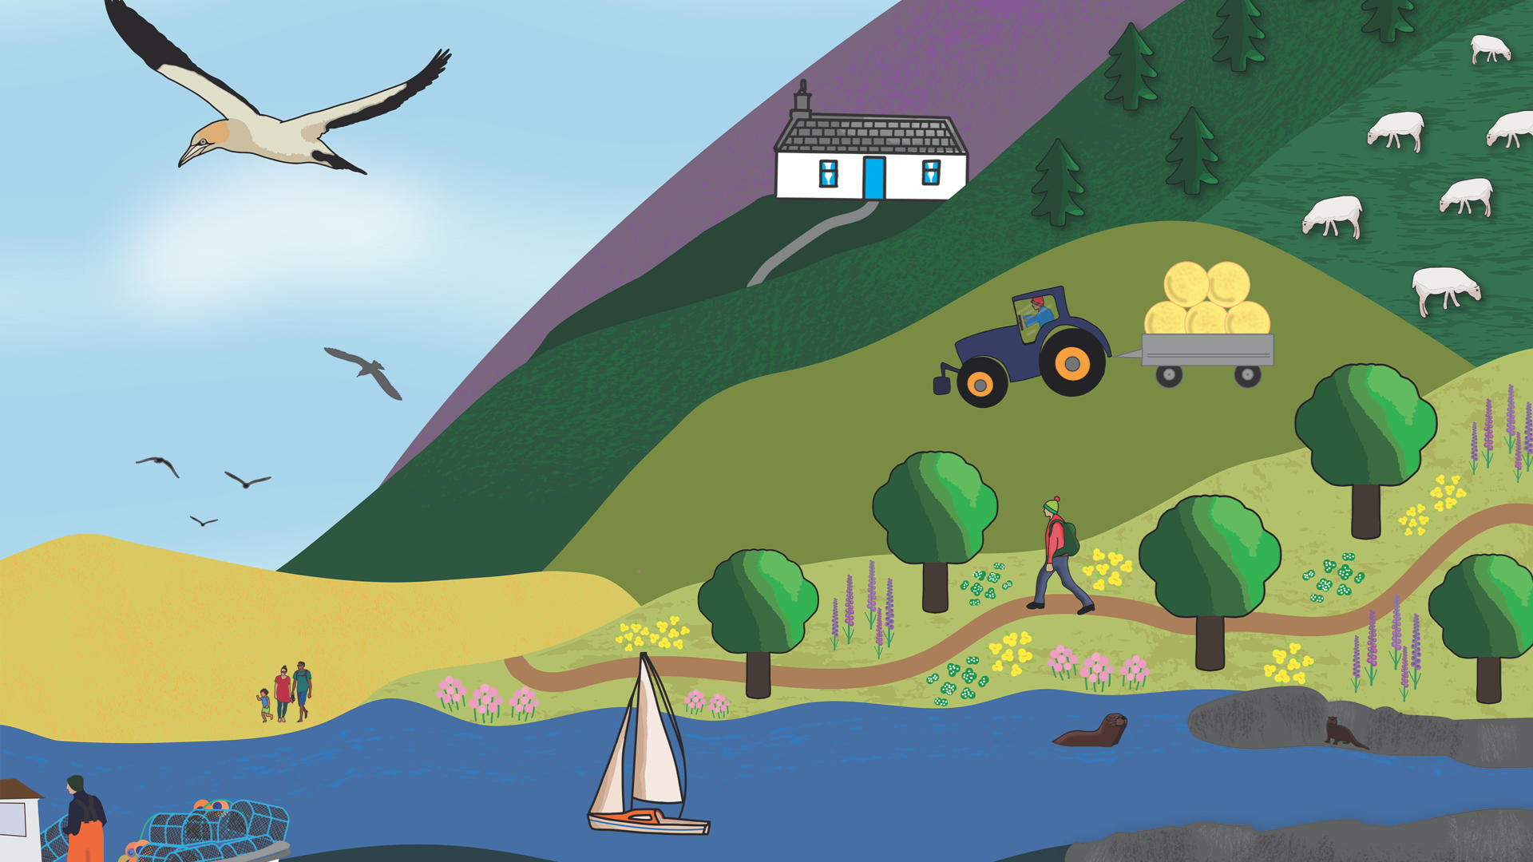


Slide 2



Saltmarshes
Activity 4: Living with the Tide
PS: 3

Slide 3
Living with the Tide
ACTIVITY 4
FOLLOWING THIS ACTIVITY, YOU SHOULD UNDERSTAND:
The different zones of a saltmarsh and which plants and animals live in each one
How the tide changes the saltmarsh and affects the living things that depend on it
SKILLS YOU WILL DEVELOP:
Observing and explaining what you see
Making and labelling models
Communicating clearly
Creating and presenting a short video
Working with others

Slide 4
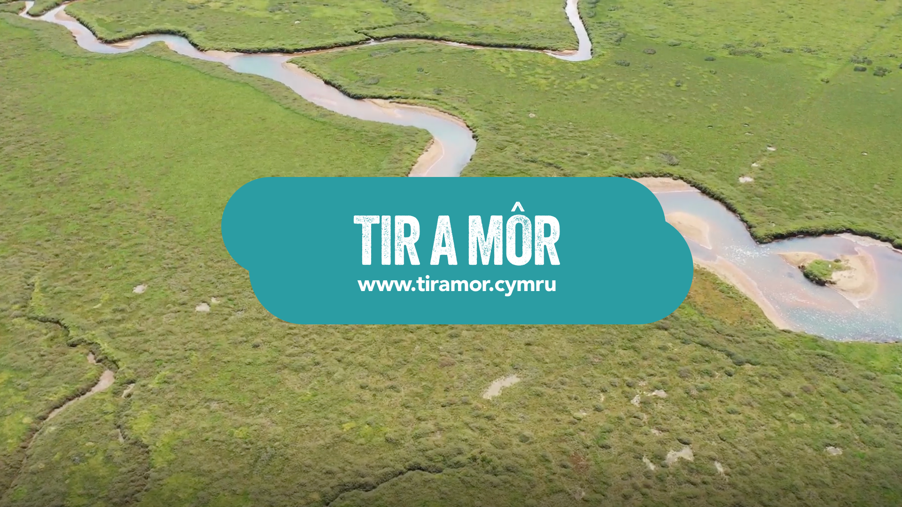
Drone Video
What do you notice as the drone travels from the mudflats to the upper marsh?
ACTIVITY 4: Living with the Tide
Saltmarshes
PLAY VIDEO
PS: 3
PHOTO: John Archer-Thompson

Slide 5

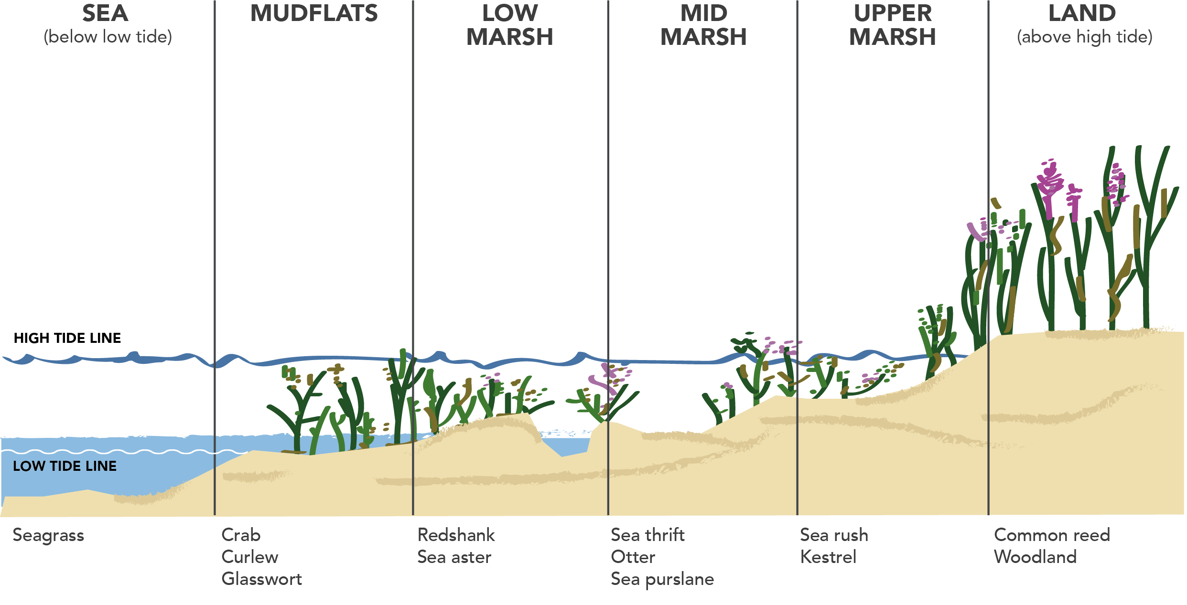
Key Features of a Saltmarsh
What are the key features of a saltmarsh?
ACTIVITY 4: Living with the Tide
Saltmarshes
PS: 3

Slide 6
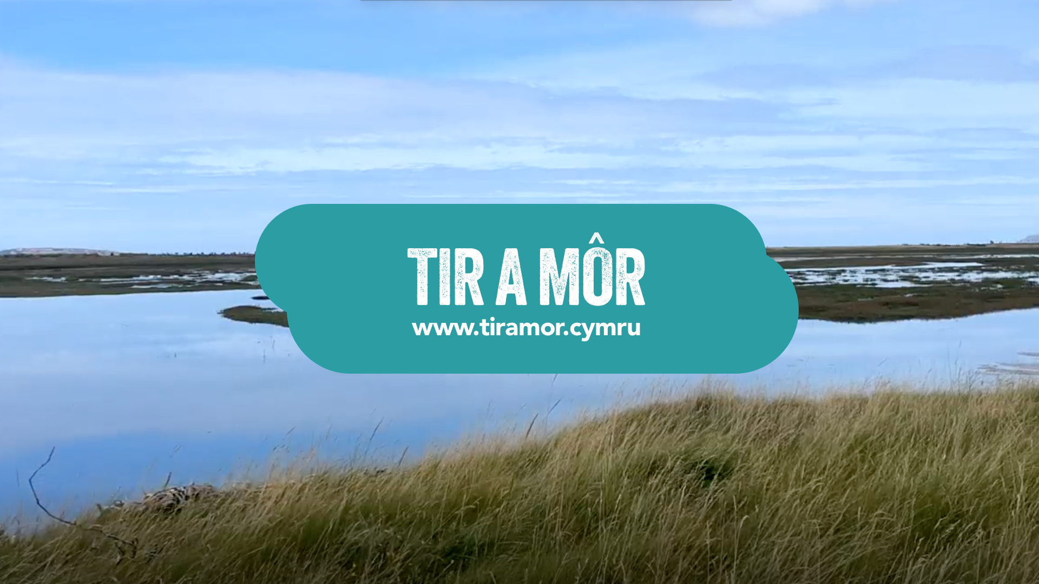
Time-lapse
What do you notice in this video?
What changes?
Is the tide coming in or going out?
What disappears or reappears?
ACTIVITY 4: Living with the Tide
Saltmarshes
The time-lapse recording started at 1:00pm and finished at 2:30pm
How many minutes long was the recording?
PLAY VIDEO
PS: 3
Write the start and finish times as 24-hour digital clock.
PHOTO: John Archer-Thompson

Slide 7
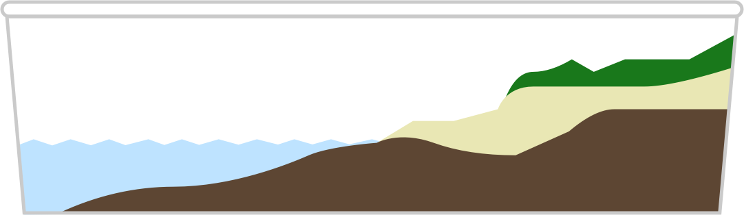
Create a Saltmarsh Model
ACTIVITY 4: Living with the Tide
Saltmarshes
STEP 1
STEP 2
STEP 3
STEP 4
Start by dividing your tray or box into sections that show the different zones of a saltmarsh, from the sea to the land.
Next, use materials like clay, Lego, or sponge to build each zone, making sure the land gently rises as you go.
Then add small models, drawings, or labels to show which animals and plants live in each zone.
Finally, use blue ribbon or paper to show how far the tide comes in.
PS: 2/3

Slide 8
Create a video
Additional Activity
SENTENCE STARTERS:
Work with your group to make a short video tour or give an oral presentation about your saltmarsh model
“Welcome to our Saltmarsh”
“In the lower marsh, you will find …”
“This part gets covered at high tide, so animals here must …”
“Saltmarshes help people by …”
ACTIVITY 4: Living with the Tide
Begin by introducing your model.
Saltmarshes
Then, describe what can be found in each part. You can also explain how Saltmarshes help people.
Record your video in pairs or as a group. Remember to speak clearly and show each part of your model.
PS: 2/3

Slide 9





